Slide 1

Online Super Shop Management System
Presented BY:
Md. Taofick Mahmoodur Rahaman
ID: 221-35-847
MD Mubtasim Fuad Khan
ID: 221-35-883
Md. Rakib Hasan
ID: 221-35-964

Slide 2
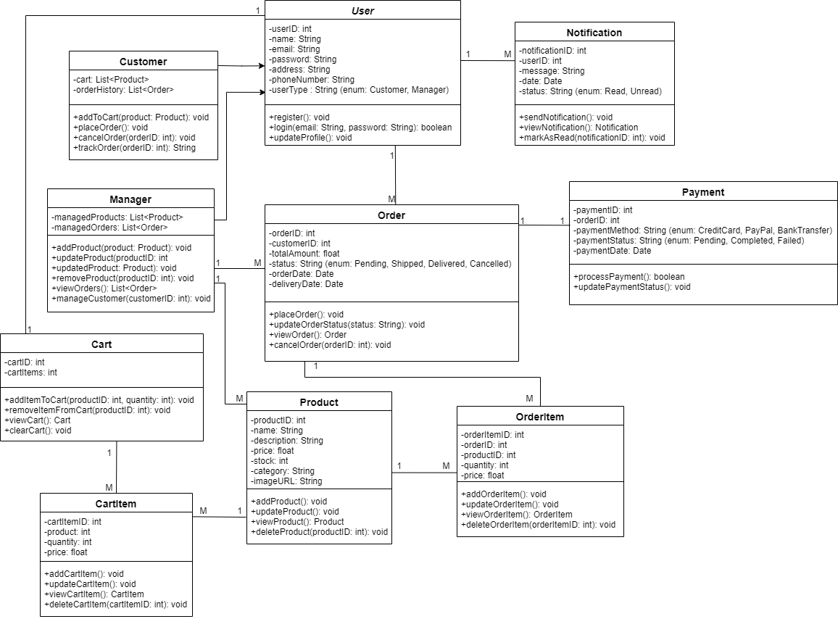
Class Diagram

Slide 3
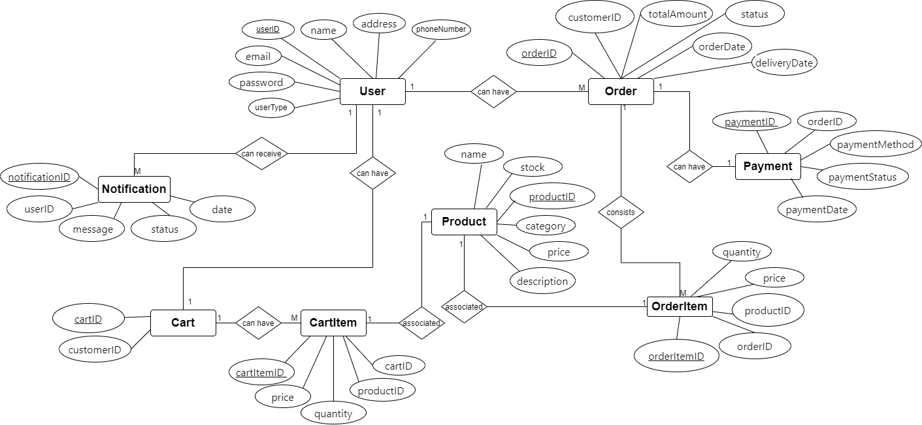
ER Diagram

Slide 4
Thank You
Any Question?

